Slide 1
Assertive Communication
Maria Lynch
confidencebuilding.ie
Notes:
This ppt will be recorded
You can still be a nice person
No need for personality transplant
Set up a positive intention
Relax any unnecessary tensions

Slide 2
Objectives
Understand what is assertiveness
Recognise what is and what isn’t assertive behaviour
How to communicate assertively
How to say NO with conviction
Notes:
Self awareness
Linking confidence self esteem and assertiveenss
Reflect on your Trigger
Situations you find difficult
People
When? How to say no clear and directly with no mixed signals , with conviction, direct , how to make an assertive refusal
as opposed to indirectly with no conviction

Slide 3
Assertiveness means standing up for your own rights while acknowledging those of other people coming across in a respectful, direct, solution-focused way
confidencebuilding.ie
Notes:
COVER SLIDE You can still be a nice person
No need for personality transplant
On and off button

Slide 4
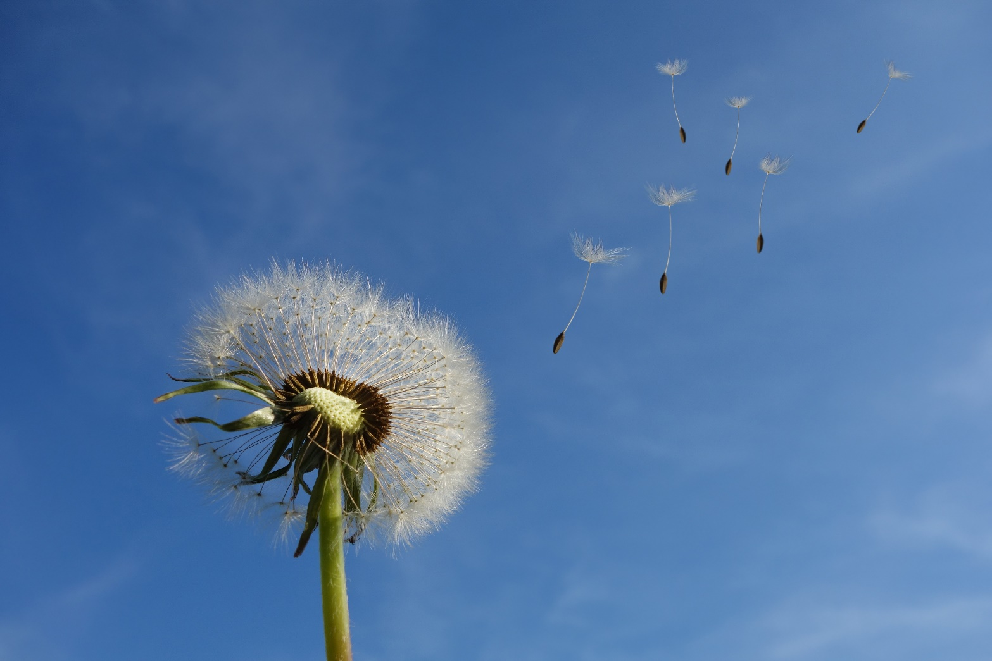
Foundations
Respect
Rights
Responsibilities
confidencebuilding.ie

Slide 5
Common negative beliefs around becoming assertive
Being selfish
Uncaring
Mean
Rude
Aggressive
Abrupt
It will cause others to take offence
It ill make others feel hurt or rejected

Slide 6
Assertive Behaviour is
appropriate behaviour
PASSIVE
PASSIVE AGGRESSIVE
ASSERTIVE
I AM OK
YOU ARE OK
ADULT
RESPECT
AGGRESSIVE
Notes:
Sscale
Inappropriate behaviour which is passive, passive -aggressive or aggressive (E.g. Bossiness, shouting bitchiness, arrogance)
Researchers use the concepts of life positions as the basis to understand assertive behaviour.
Life positions theory mentions four types of behaviour: aggressive, assertive, passive and defensive behaviours.
For the purpose of this course we will focus on the aggressive, Passive /Submissive and assertive behaviours.
The aggressive person’s mind frame believes strongly that they are OK, “I’m right you are wrong”, “I am the boss, I will decide”
The passive view of the world is that they are not OK. When confronted with issues they are inclined to withdraw, say nothing and internalise the issues. They tend to
exhibit a type of martyrdom .
Assertive is the ideal behaviour. It’s about standing up for your own rights without infringing on the right of others. They re honest, have strong self-respect and respect for others. They re open, have high self-esteem, are into win-win situations and adopt Adult-type behaviour. Their life view is “I’M ok, you’re OK”,. “I am not better or worse than anyone else”
Non verbal, verbal & physiological responses ? Bossiness, shouting bitchiness, arrogance)
Life positions view of the worls
What is it and what isn’t assertive behaviour
BEHAVIOUR : what we do

Slide 8
Be clear and direct
Economy of words
Own what you say. Use I-statements: I think,
I would like, In my opinion…
State it calmly, firmly and with respect

Slide 9
This situation has to change This is not going to work for me I am not comfortable with this I need more time to think about this This is not the right time for me
Making clear statements

Slide 10
I feel angry when you break your agreements I feel really awkward saying this but … I would prefer you not to smoke in here I would like to let you know how I am feeling so it will clear the air between us I find it difficult to ask but would you…
Expressing feelings

Slide 11
Saying NO
A basic right
In tune with our inner guidance
Help us to set limits
Say it with clarity, conviction and without aggression
confidencebuilding.ie
Notes:
COVER SLIDE

Slide 12
No. This arrangement doesn’t suit me No. I would rather not take part on this No. I am not comfortable with this I feel guilty at having to say No to you but I must refuse I need more time to think about this
Making clear statements

Slide 13
Remember
Avoid the Compassion Trap
It is OK to set limits
When you say NO you are refusing the request, not the person
confidencebuilding.ie
Notes:
COVER SLIDE You can still be a nice person
No need for personality transplant
On and off button

Slide 14
Live Q&A
confidencebuilding.ie
Notes:
COVER SLIDE

Slide 15
Maria Lynch
confidencebuilding.ie
THANK YOU!

